Slide 1
Frailty, frail, frail phenotype, frail index
Chronic kidney disease, chronic renal disease, chronic kidney insufficiency, chronic renal insufficiency, kidney transplant, renal transplant, end-stage kidney disease, end-stage renal disease, kidney, renal
0, Complication, cause, etiology/aetiology

Slide 2
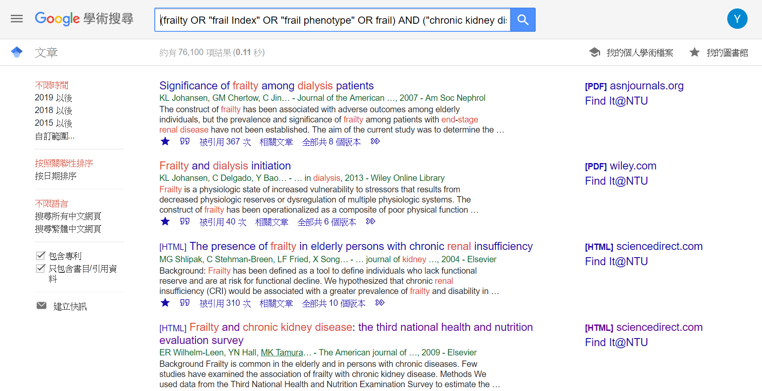
(frailty OR "frail Index" OR "frail phenotype" OR frail) AND ("chronic kidney disease" OR "end-stage kidney disease" OR "end-stage renal disease" OR kidney OR renal OR dialysis OR "renal transplant" OR "kidney transplant")

Slide 3
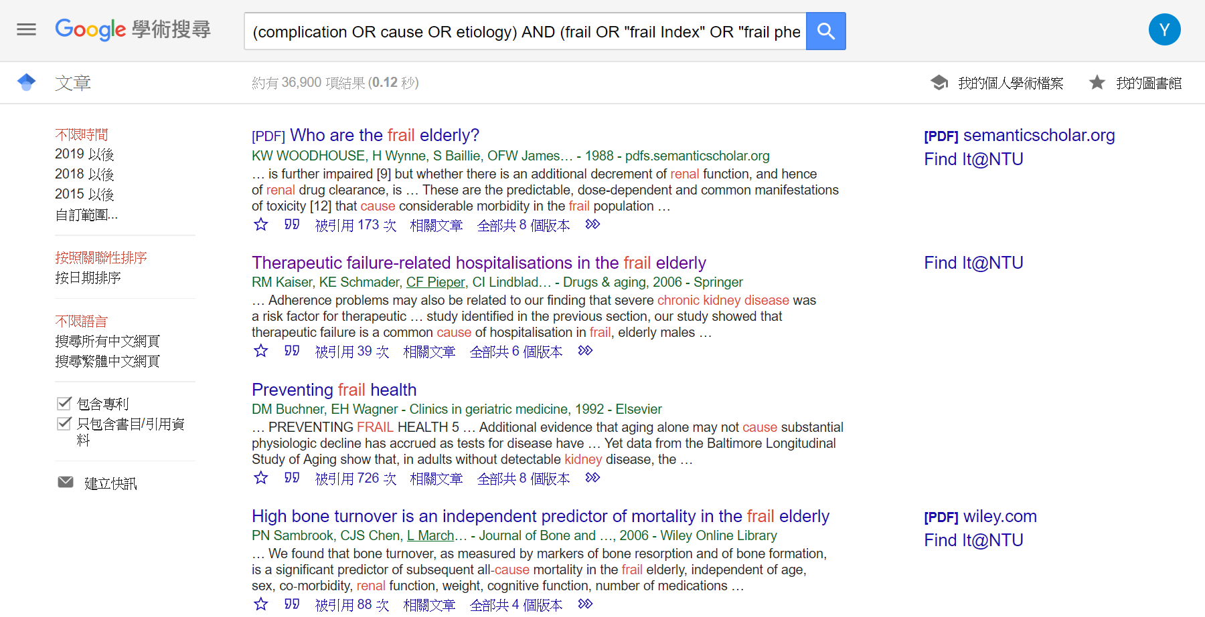
(complication OR cause OR etiology) AND (frail OR "frail Index" OR "frail phenotype") AND ("chronic kidney disease" OR "end-stage kidney disease" OR "end-stage renal disease" OR kidney OR renal OR dialysis OR "renal transplant" OR "kidney transplant")

Slide 4
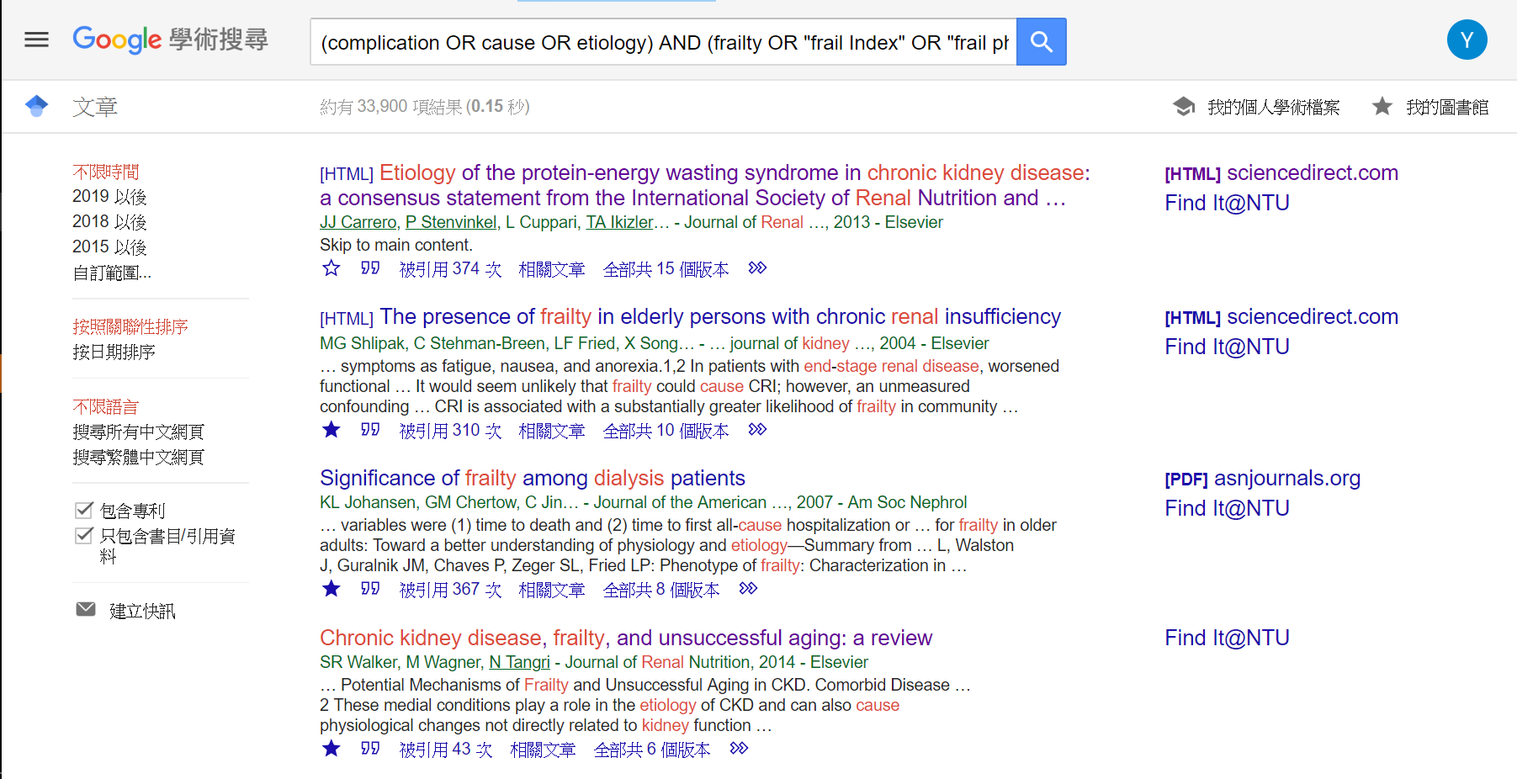
(complication OR cause OR etiology) AND (frailty OR "frail Index" OR "frail phenotype") AND ("chronic kidney disease" OR "end-stage kidney disease" OR "end-stage renal disease" OR kidney OR renal OR dialysis OR "renal transplant" OR "kidney transplant")

Slide 5
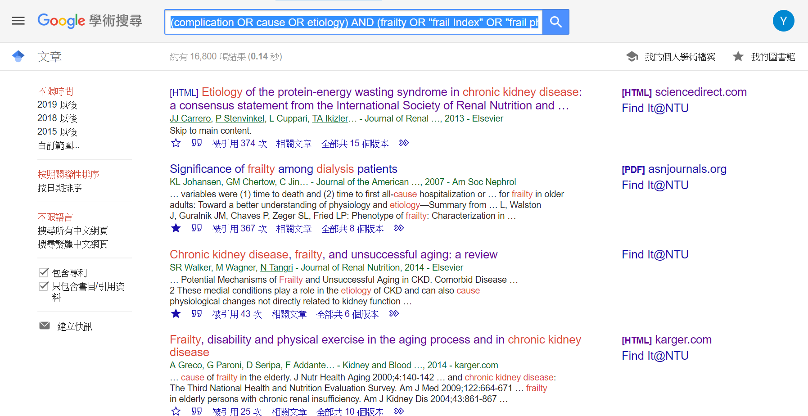
(complication OR cause OR etiology) AND (frailty OR "frail Index" OR "frail phenotype") AND ("chronic kidney disease" OR "end-stage kidney disease" OR "end-stage renal disease" OR dialysis OR "renal transplant" OR "kidney transplant")

Slide 6
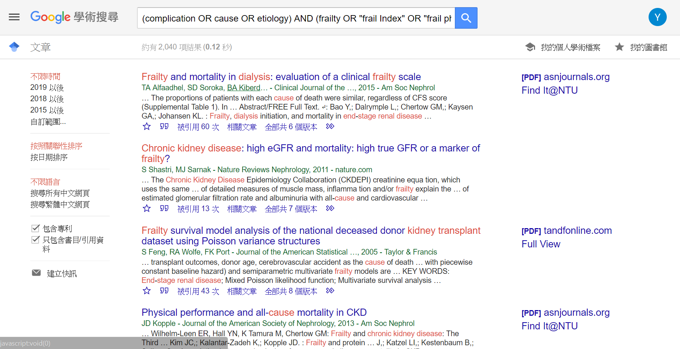
(complication OR cause OR etiology) AND (frailty OR "frail Index" OR "frail phenotype") AND ("chronic kidney disease" OR "end-stage kidney disease" OR "end-stage renal disease" OR dialysis OR "renal transplant" OR "kidney transplant") -review

Slide 7
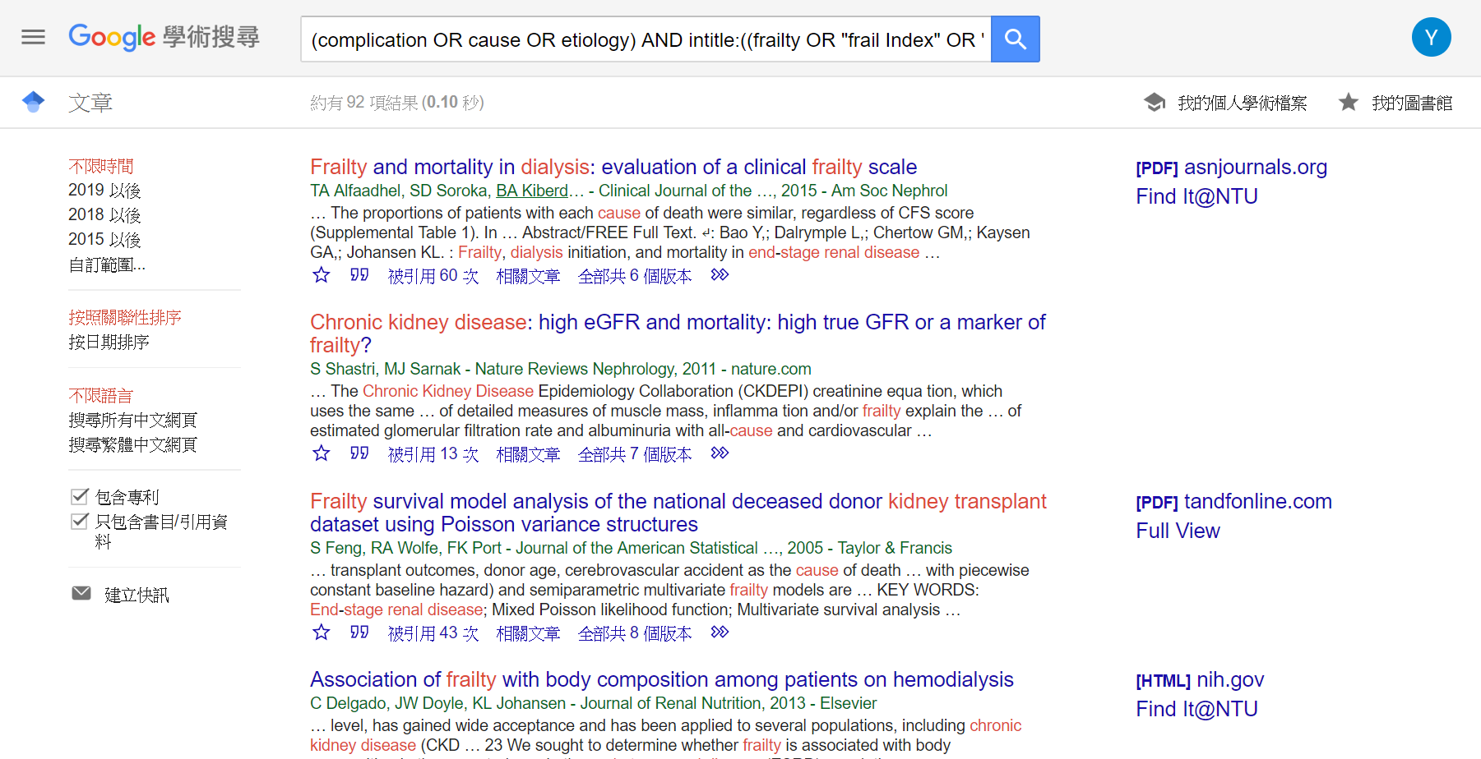
(complication OR cause OR etiology) AND intitle:((frailty OR "frail Index" OR "frail phenotype") AND ("chronic kidney disease" OR "end-stage kidney disease" OR "end-stage renal disease" OR dialysis OR "renal transplant" OR "kidney transplant")) -review

Slide 8
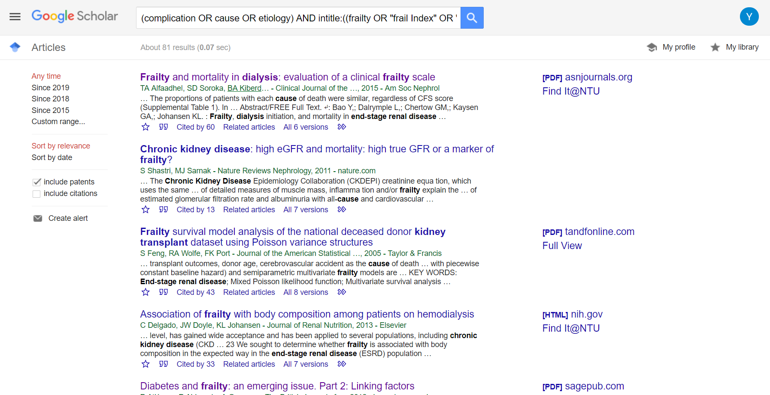
(complication OR cause OR etiology) AND intitle:((frailty OR "frail Index" OR "frail phenotype") AND ("chronic kidney disease" OR "end-stage kidney disease" OR "end-stage renal disease" OR dialysis OR "renal transplant" OR "kidney transplant")) -review

Slide 9
Frailty, frail, frail phenotype, frail index
Chronic kidney disease, chronic renal disease, chronic kidney insufficiency, chronic renal insufficiency, kidney transplant, renal transplant, end-stage kidney disease, end-stage renal disease, kidney, renal
0, complication, complication, cause, etiology/aetiology

Slide 10
 | Frailty | Frail | Frail phenotype | Frail index
Chronic kidney disease | 170, 47, 18, 63
Chronic renal disease | 7, 1, 2, 0
Chronic kidney insufficiency | 0, 0, 0, 0
Chronic renal insufficiency | 89, 35, 8, 51
Kidney transplant | 46
Renal transplant
End-stage kidney disease
End-stage renal disease
Kidney
Renal
https://patrickwoolf.github.io/Search-Engine-_Frailty/
frailty AND "chronic kidney disease" AND …; Sort by “Most recent”
PubMed

Slide 11
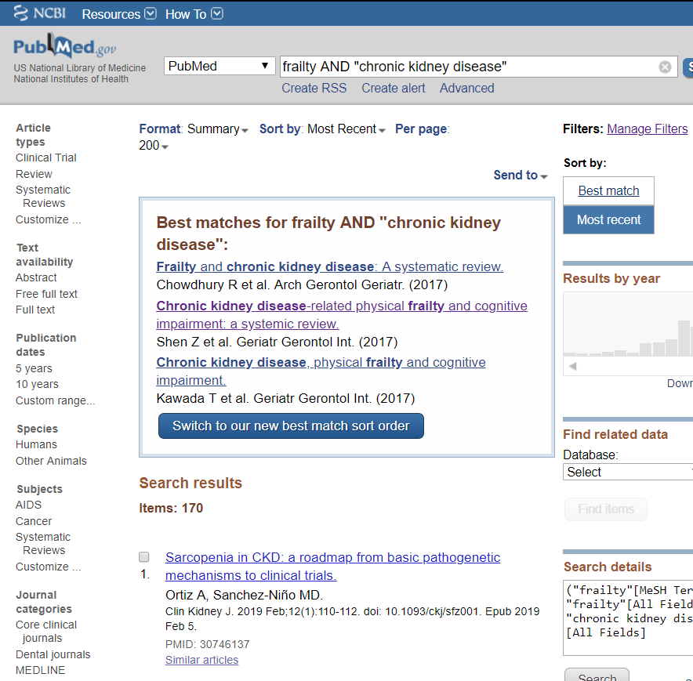
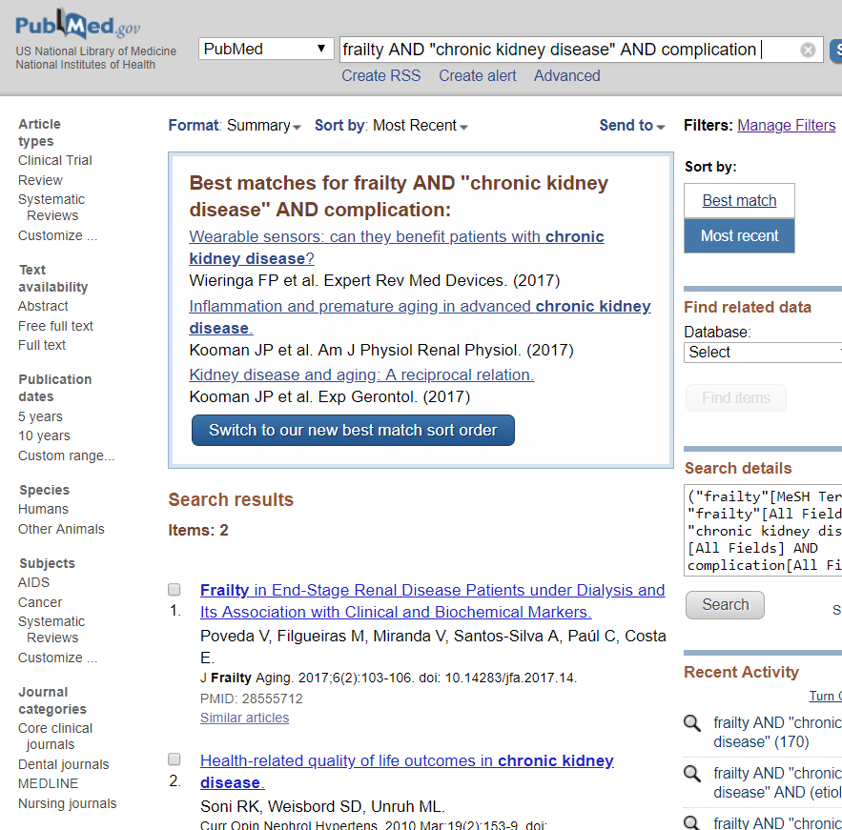
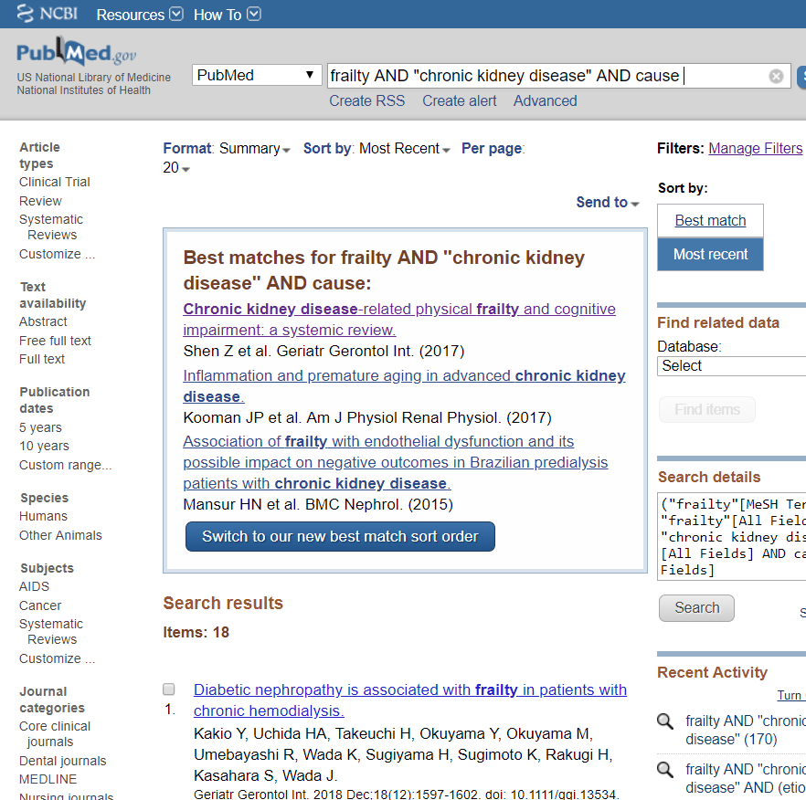
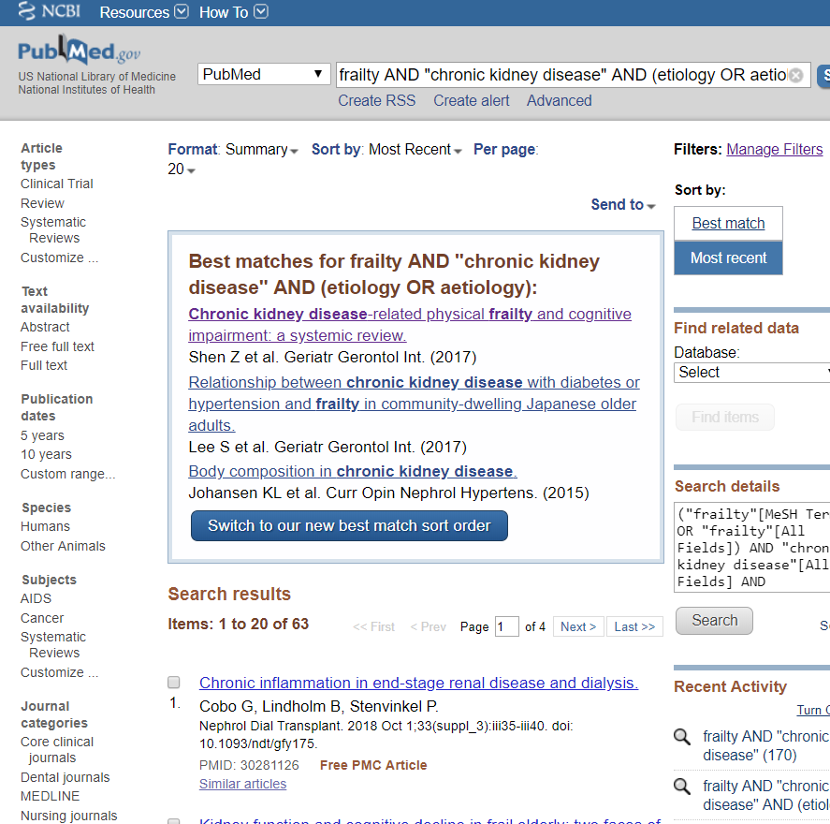

Slide 12
frailty AND "chronic kidney disease": 170
frailty AND "chronic kidney disease" AND complication: 2
frailty AND "chronic kidney disease" AND complications: 46
frailty AND "chronic kidney disease" AND cause: 18
frailty AND "chronic kidney disease" AND causes: 66
frailty AND "chronic kidney disease" AND (etiology OR aetiology): 63
frailty AND "chronic renal disease": 7
frailty AND "chronic renal disease" AND complication: 0
frailty AND "chronic renal disease" AND complications: 1
frailty AND "chronic renal disease" AND cause: 2
frailty AND "chronic renal disease" AND causes: 1
frailty AND "chronic renal disease" AND (etiology OR aetiology): 0
frailty AND "chronic kidney insufficiency": 0
frailty AND "chronic kidney insufficiency" AND complication: 0
frailty AND "chronic kidney insufficiency" AND complications: 0
frailty AND "chronic kidney insufficiency" AND cause: 0
frailty AND "chronic kidney insufficiency" AND causes: 0
frailty AND "chronic kidney insufficiency" AND (etiology OR aetiology): 0
frailty AND "chronic renal insufficiency": 89
frailty AND "chronic renal insufficiency" AND complication: 0
frailty AND "chronic renal insufficiency" AND complications: 35
frailty AND "chronic renal insufficiency" AND cause: 8
frailty AND "chronic renal insufficiency" AND causes: 52
frailty AND "chronic renal insufficiency" AND (etiology OR aetiology): 51
frailty AND "kidney transplant": 46
frailty AND "kidney transplant" AND complication: 1
(Rossignol J, Radioimmunotherapy ((90) Y-Ibritumomab Tiuxetan) for Posttransplant Lymphoproliferative Disorders After Prior Exposure to Rituximab. )
frailty AND "kidney transplant" AND complications: 11
frailty AND "kidney transplant" AND cause: 6
frailty AND "kidney transplant" AND causes: 12
frailty AND "kidney transplant" AND (etiology OR aetiology): 12
frailty AND "renal transplant": 6
frailty AND "renal transplant" AND complication: 0
frailty AND "renal transplant" AND complications: 1
(Personalized immunosuppression in elderly renal transplant recipients.)
frailty AND "renal transplant" AND cause: 0
frailty AND "renal transplant" AND causes: 1
(Acute Esophageal Necrosis in an Immunosuppressed Kidney Transplant Recipient: A Case Report. )
frailty AND "renal transplant" AND (etiology OR aetiology): 1
(Acute Esophageal Necrosis in an Immunosuppressed Kidney Transplant Recipient: A Case Report.)
frailty AND "end-stage kidney disease": 15
frailty AND "end-stage kidney disease" AND complication: 0
frailty AND "end-stage kidney disease" AND complications: 4
frailty AND "end-stage kidney disease" AND cause: 3
frailty AND "end-stage kidney disease" AND causes: 4
frailty AND "end-stage kidney disease" AND (etiology OR aetiology): 4
frailty AND "end-stage renal disease": 96
frailty AND "end-stage renal disease" AND complication: 3
frailty AND "end-stage renal disease" AND complications: 25
frailty AND "end-stage renal disease" AND cause: 12
frailty AND "end-stage renal disease" AND causes: 27
frailty AND "end-stage renal disease" AND (etiology OR aetiology): 27

Slide 13
frailty AND "kidney": 469
frailty AND "kidney" AND complication: 9
frailty AND "kidney" AND complications: 130
frailty AND "kidney" AND cause: 59
frailty AND "kidney" AND causes: 187
frailty AND "kidney" AND (etiology OR aetiology): 179
frailty AND "renal": 483
frailty AND "renal" AND complication: 17
frailty AND "renal" AND complications: 141
frailty AND "renal" AND cause: 60
frailty AND "renal" AND causes: 198
frailty AND "renal" AND (etiology OR aetiology): 187
(frail AND (frail OR phenotype OR index)) AND "chronic kidney disease": 115
(frail AND (frail OR phenotype OR index)) AND "chronic kidney disease" AND complication: 2
(frail AND (frail OR phenotype OR index)) AND "chronic kidney disease" AND complications: 30
(frail AND (frail OR phenotype OR index)) AND "chronic kidney disease" AND cause: 14
(frail AND (frail OR phenotype OR index)) AND "chronic kidney disease" AND causes: 39
(frail AND (frail OR phenotype OR index)) AND "chronic kidney disease" AND (etiology OR aetiology): 37
(frail AND (frail OR phenotype OR index)) AND ("chronic kidney disease" OR "chronic renal disease" OR "chronic kidney insufficiency" OR "chronic renal insufficiency" OR "kidney transplant" OR "renal transplant" OR "end-stage kidney disease" OR "end-stage renal disease"): 277
(frail AND (frail OR phenotype OR index)) AND ("chronic kidney disease" OR "chronic renal disease" OR "chronic kidney insufficiency" OR "chronic renal insufficiency" OR "kidney transplant" OR "renal transplant" OR "end-stage kidney disease" OR "end-stage renal disease") AND complication: 4
(frail AND (frail OR phenotype OR index)) AND ("chronic kidney disease" OR "chronic renal disease" OR "chronic kidney insufficiency" OR "chronic renal insufficiency" OR "kidney transplant" OR "renal transplant" OR "end-stage kidney disease" OR "end-stage renal disease") AND complications: 61
(frail AND (frail OR phenotype OR index)) AND ("chronic kidney disease" OR "chronic renal disease" OR "chronic kidney insufficiency" OR "chronic renal insufficiency" OR "kidney transplant" OR "renal transplant" OR "end-stage kidney disease" OR "end-stage renal disease") AND cause: 18
(frail AND (frail OR phenotype OR index)) AND ("chronic kidney disease" OR "chronic renal disease" OR "chronic kidney insufficiency" OR "chronic renal insufficiency" OR "kidney transplant" OR "renal transplant" OR "end-stage kidney disease" OR "end-stage renal disease") AND causes: 80
(frail AND (frail OR phenotype OR index)) AND ("chronic kidney disease" OR "chronic renal disease" OR "chronic kidney insufficiency" OR "chronic renal insufficiency" OR "kidney transplant" OR "renal transplant" OR "end-stage kidney disease" OR "end-stage renal disease") AND (etiology OR aetiology): 77
(frail AND (frail OR phenotype OR index)) AND (renal OR kidney)
(frail AND (frail OR phenotype OR index)) AND (renal OR kidney) AND complication
(frail AND (frail OR phenotype OR index)) AND (renal OR kidney) AND complications
(frail AND (frail OR phenotype OR index)) AND (renal OR kidney) AND cause
(frail AND (frail OR phenotype OR index)) AND (renal OR kidney) AND causes
(frail AND (frail OR phenotype OR index)) AND (renal OR kidney) AND (etiology OR aetiology)

Slide 14
 | Frailty | Frail | Frail phenotype | Frail index
Chronic kidney disease
Chronic renal disease
Chronic kidney insufficiency
Chronic renal insufficiency
Kidney transplant
Renal transplant
End-stage kidney disease
End-stage renal disease
Kidney
Renal
frailty AND "chronic kidney disease" AND …; Sort by “Most recent”
Medline

